Slide 1
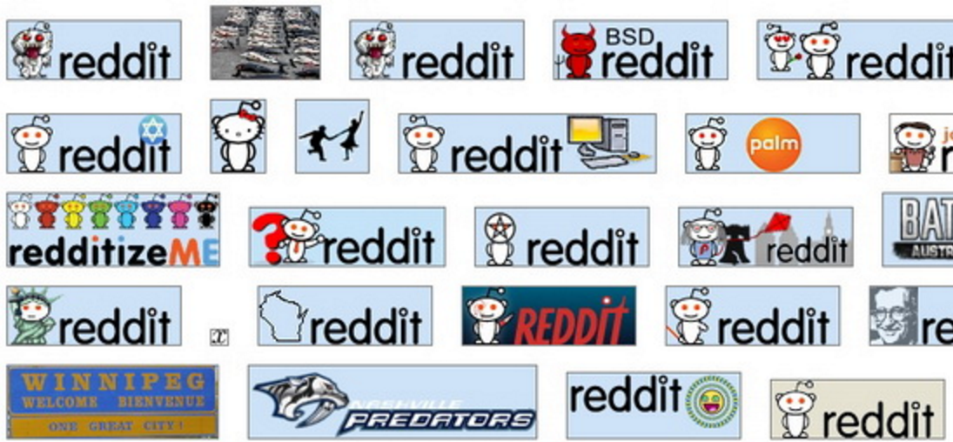
Subreddit Recommendation Engine
Thomas Voreyer

Slide 2
Where to Begin
My initial project was to determine relevance of a news article to the stock market
The project proved to be unachievable given my methodology
For ideas, I looked at the code written for webscraping and the already compiled data
I decided that Reddit had a wealth of information, and that it would be smart to continue using it

Slide 3
The Project
I looked at the data and thought about identifying how users differ in preference and personality
From there, I determined that user personality could be inferred from subreddit personality
So, I made it my primary objective to infer a subreddit personality

Slide 4
The Data
Started the project with the Top 100 posts of the past year for the Top 100 Subreddits
Expanded this number to the top 250 Subreddits
(25,000 Posts)
Information Gathered:
Post Name
Post Link Type (.com, .html, .png, .gif, …)
All associated comments
Post score

Slide 5
Inferring Personality
I generated word lists corresponding to personality traits and ideologies
I would go through the comments of each subreddit to determine which word lists were most present
I would infer personality based upon the relative occurrences of these word lists
I would also infer personality from what format the post was (com, gif, html, …)

Slide 6
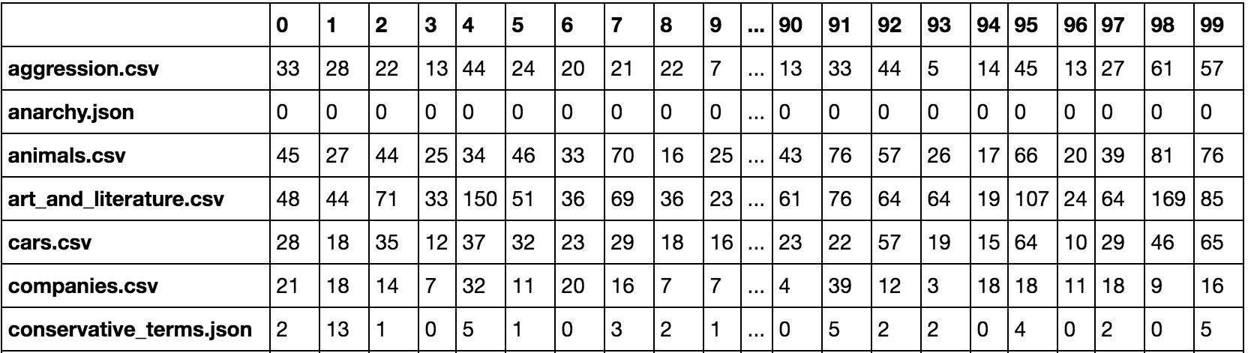
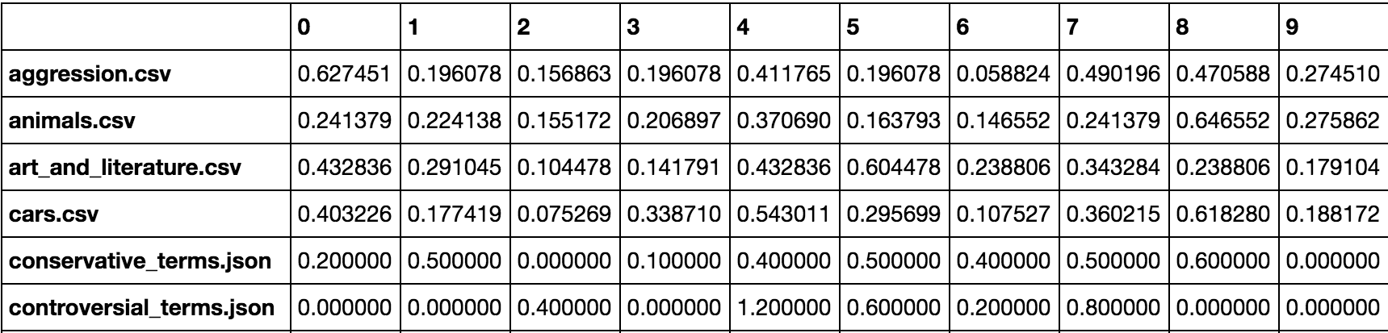
Post-Category_List Matrices
Raw Data
Relative TF per Post Across All Subreddits

Slide 7
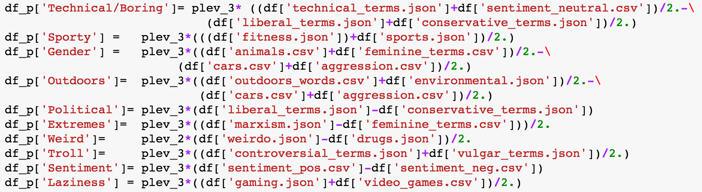
A Better PCA
PCA reduces dimensions in terms of variance, but information such as variance and axes are lost
I created ‘personality’ axes that were composed of the original features; from 29 original features to 10 inferred features
Idea was to eliminate an overabundance of information

Slide 8
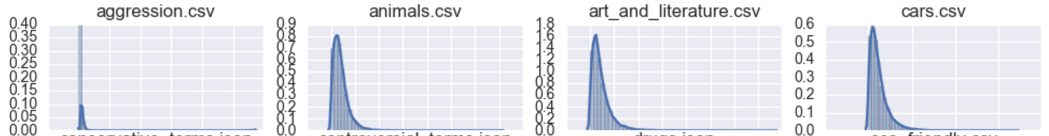
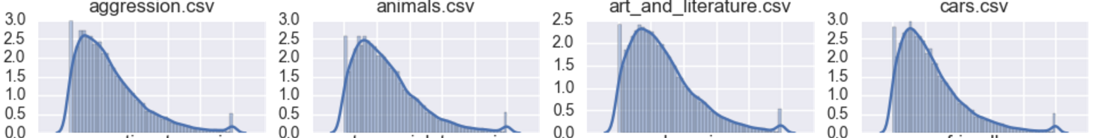
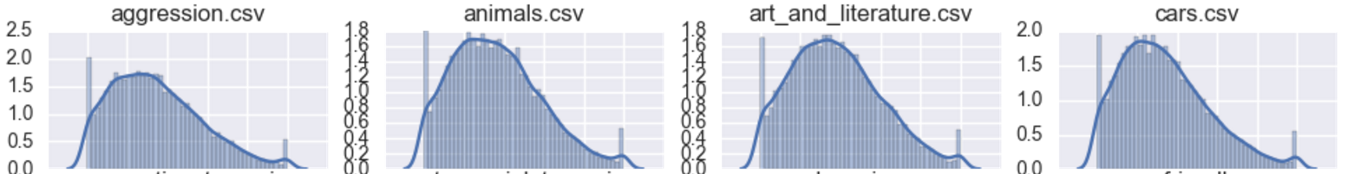
Did the Data Need ‘Adjustment’?
Step 1: MinMax Scaling
Step 2: Normalization Scaling
Step 3: Log Normalization

Slide 9
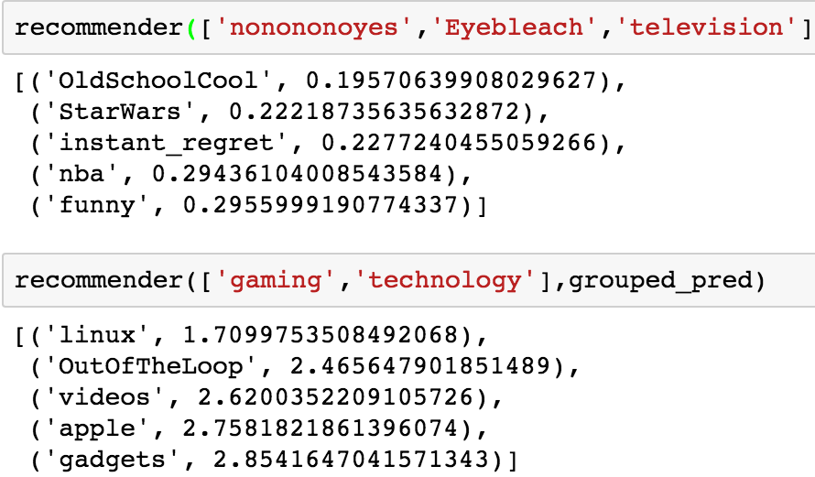
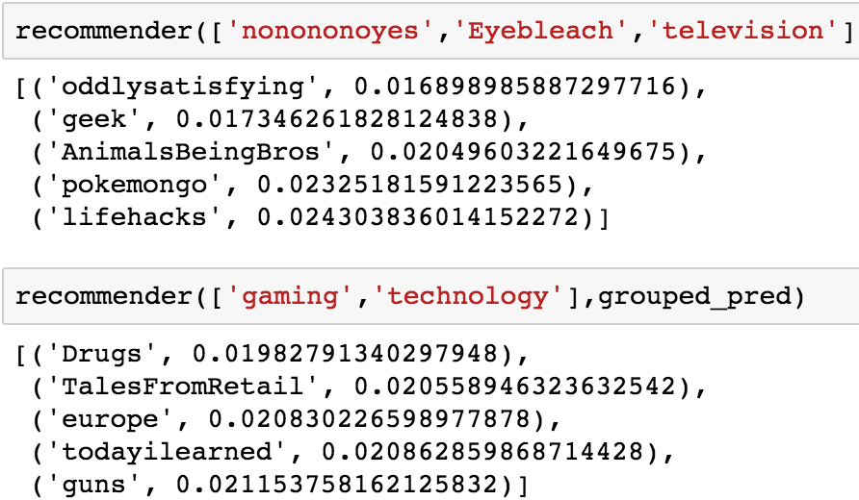
Prediction Results
Only Min Max Scaling
All Normalization
Different normalizations and scaling really affects predictions
I opted to use only the min max scaling
It would make sense to leave outliers as outliers

Slide 10
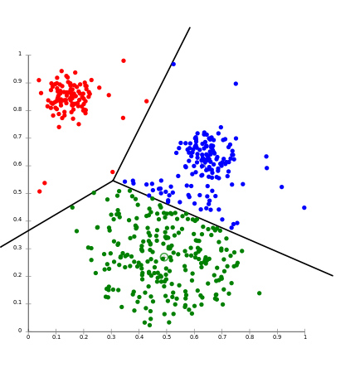
Predicting Clusters
Creating clusters was much easier than finding similar subreddits
Subreddit ‘personalities’ can vary a lot despite similar content
Clustering only cared about personalities, and not content.
Clustering was more of a mixed bag, but was more consistent

Slide 11
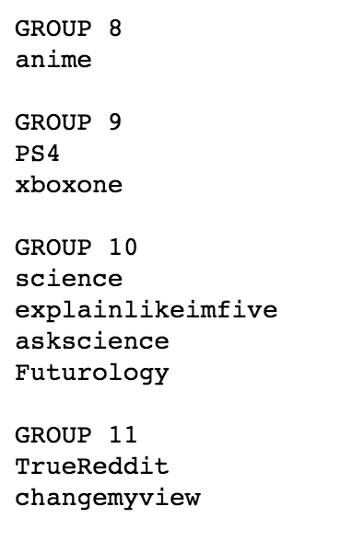
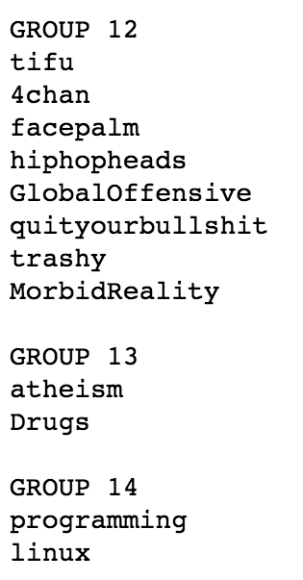
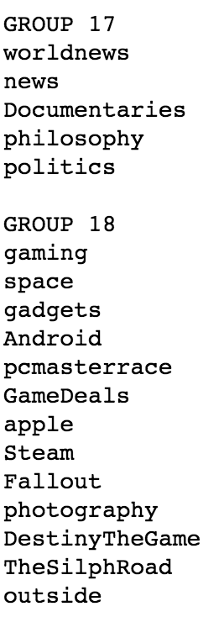
Some of the Predicted Groups

Slide 12
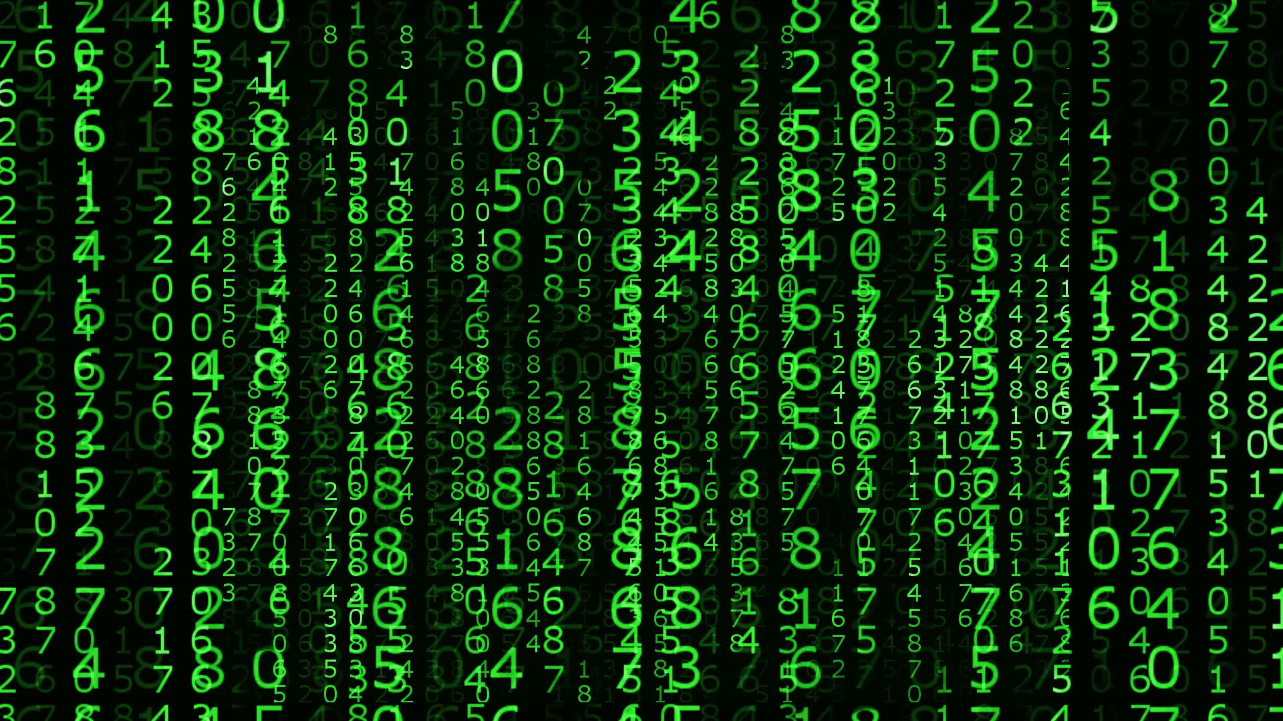
Let’s Do Some Predictions

Slide 13
After Thoughts
Project consisted of 3 parts:
Scraping
Cleaning and Preparation of Data
Modeling and Predictions
1 and 2 had clear hurdles, 3 was painful
I only had my subjection to determine accuracy, and no possible automated method for iterations of personality factors

Slide 14
After Thoughts
The largest take away of this project has been respecting raw data
Not everything needs to be tranformed!
For instance, I was using PCA and various normalizations, but I didn’t realize how it was obscuring the uniqueness of subreddit personalities
My advice: Don’t rush into these techniques we have ‘learned’. It is better to naturally transform the data

Slide 15
Questions?

